Slide 1

Society Sync: Connecting residents
for better living
SAHIL GORDE 22107035
SOHAM DEVRUKHKAR 22107054
VARAD CHAUDHARI 22107053
AYUSH MAURYA 22107029
Project Guide
Ms.Sarala Mary

Slide 2
Outline
Introduction
Literature Survey of the existing systems
Limitations of the existing systems
Problem statement
System Design
Technologies and methodologies
Implementation
Conclusion
References

Slide 3
Introduction
Society Sync offers a user-friendly interface and diverse features to streamline the administrative processes of a society.
It simplifies operations, enabling administrators and members to oversee all aspects efficiently, fostering transparent communication and smooth functioning.
Motivation:
Observing the widespread challenges faced by cooperative housing societies in managing their affairs efficiently.
Noticing the persistence of issues such as maintenance dues collection, dispute resolution, and administrative inefficiencies.
Having personal experiences or interactions with individuals affected by the challenges in housing society management.

Slide 4
Objectives:
To establish a centralized database system using Django.
To enhance the efficiency of day-to-day operations of society with django and python.
To implement a meeting scheduling feature using schedule library.
To automate bill and notification generation using razorpay API and websockets.

Slide 5
Literature Survey of the existing system
Author | Year | Title | Methods used | Merits | Demerits
[1]Mayank Thacker, Lay Shah, Manan Shah | 2022 | [1] Society sync Digitalize society management systems with artificial intelligence technologies | Web Development, Artificial Intelligence | 1)Enhanced transparency via real-time updates and notifications. 2)Convenience for residents to report issues, make payments, and communicate with management | 1)Adoption challenges among older residents who may not be tech-savvy.
[2]Likhitha Reddy Eddala | 2023 | [2]WEB BASED MANAGEMENT SYSTEM FOR HOUSING SOCIETY | Android Application | 1) Streamlined communication between residents and management. 2)Efficient management of resources such as water, electricity, and maintenance. | 1)Dependence on reliable internet connectivity for effective operation.

Slide 6
Literature Survey of the existing system
Author | Year | Title | Methods used | Merits | Demerits
[3]Tirth Shah | 2018 | [3]Cloud based Housing Society Management System | Web Development, Cloud computing | 1) Automated task allocation and scheduling for maintenance and repairs. | 1)Privacy concerns regarding data collection and management.

Slide 7
Limitations of existing systems
Fragmented Applications: Having separate user and admin applications creates fragmentation and complexity.
Scalability Challenges: The digital system may struggle to handle increased data volume as the housing community grows or evolves.
Limited communication channels: Communication channels may be fragmented and lack real-time updates.
Data security concerns: Weaknesses in data protection measures could expose sensitive information to unauthorized access or breaches.

Slide 8
Problem statement
Manual operations: leading to slow progress on complaints and difficulty in applying necessary steps.
Lack of awareness among members about available properties for sale/rent results in missed opportunities for those in need.
Delayed payments:Many members miss maintenance payment deadlines, incurring penalties.
Communication gaps between society committees and residents due to disparate systems.

Slide 9
System Design
home
Visitor
login/register
ADMIN
USER
Visitor Log
HOME
HOME
Complaint Status
Manage Users
Announcement
Notice Board
Maintenance bill
Complaint registration
delete

Slide 10
Technologies and methodologies
Tool
1) VS Code 5.11.3
Bachend
2) Python 4.2.1
3) Django 5.0.3
Frontend
4) HTML + CSS + Javascript

Slide 11
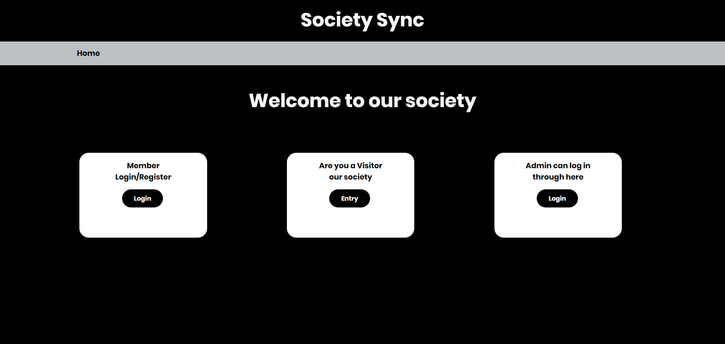
Implementation

Slide 12
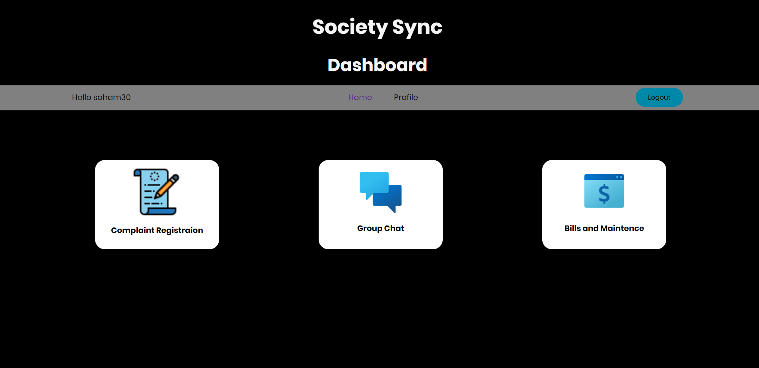
Implementation

Slide 13
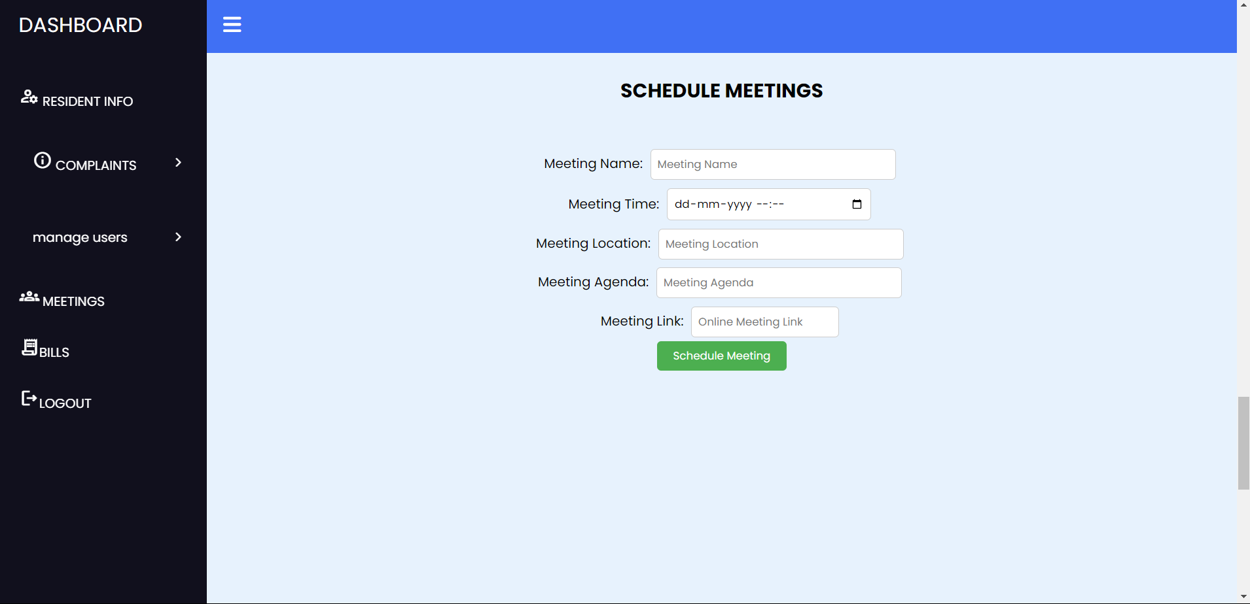
Implementation

Slide 14
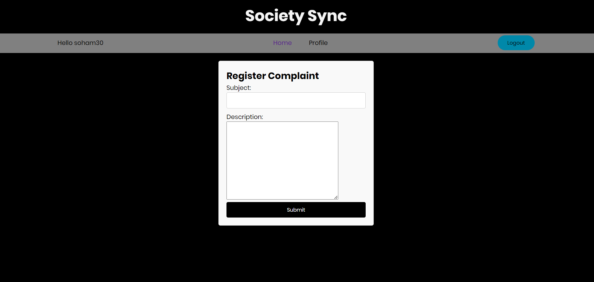
Implementation

Slide 15
References
[1] Mayank Thacker, Lay Shah, Manan Shah, “Society sync –Digitalize society management systems with artificial intelligence technologies”,LJ Institute of Engineering and Technology, Gujarat,2022.
[2] Likhitha Reddy Eddala, “WEB BASED MANAGEMENT SYSTEM FOR HOUSING SOCIETY”,California State University, San Bernardino,August 2023.
[3]Tirth Shah, “Cloud based Housing Society Management System”,SVPIT Gujarat Technological University,2018.

Slide 16
Conclusion
The project ‘society sync’ provides users with a complete bundle of all the functionality required to administer a society.
The goal is to create a one-of-a-kind society assistance platform that can be utilized by both small and large societies.
The demand for this product is growing in the market since it digitalizes and reducing the workload of secretaries, while also enhancing transparency.

Slide 17
Thank You...!!

